Slide 1
Convergence of Fixed Geometry Nozzles Using the Pseudo-1D Euler Equations
Alex Le & Christopher Uyeda

Slide 2
Outline
Physical Model
Pseudo-1D Euler Equations
Numerical Method
Approximate Riemann Solvers
Two Stage Runge-Kutta
Boundary Conditions
Numerical Results

Slide 3
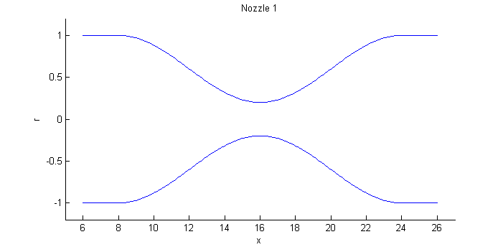
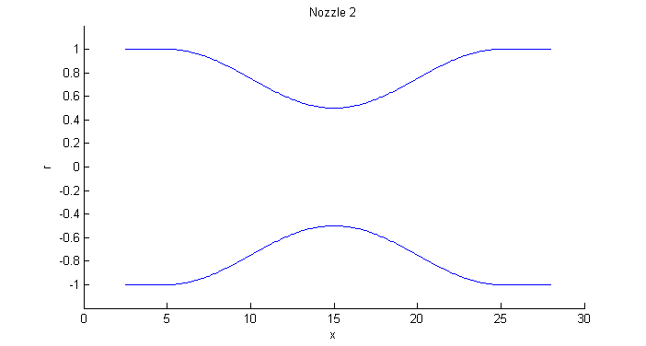
Physical Model
Simulating two different fixed geometry converging-diverging nozzle. Inlet is fixed to a pressure reservoir and exhausts out to ambient environment.
r = 1 – 0.4(1 + cos(π[x – 16]/8))
Area ratio: 25
2) r= 0.75-0.25 sin(π (x-10)/10)
Area ratio: 4

Slide 4
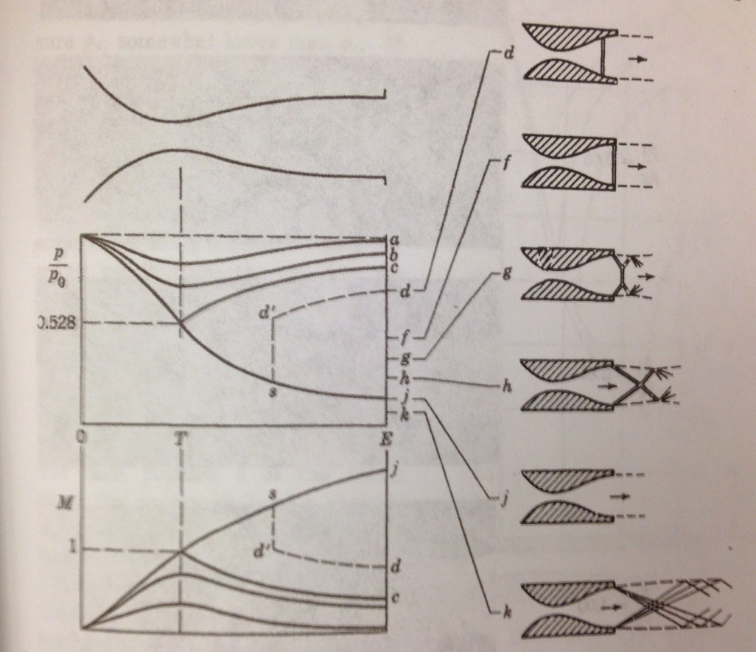
Flow Types
Three types of flow are possible which are purely dependent on the pressure ratio between the outlet and inlet, P_{r}
Pure Subsonic – Flow is subsonic throughout entire converging-diverging nozzle due to P_{r} being above a pressure ratio threshold for subsonic flow.
Pure Supersonic – Flow is sonic at throat and supersonic throughout the remaining diverging section of the nozzle due to low P_{r}. This P_{r} remains below a certain pressure ratio threshold for supersonic flow.
Choked Subsonic – Flow turns sonic at throat and continues to accelerate to supersonic flow; however, a shock forms. Shock exists because P_{r} is between the supersonic and subsonic pressure ratio thresholds such that the flow can’t naturally expand out to the ambient back pressure so a shock forms.
Pressure Ratio effects on Flow Types [2]

Slide 5



Pseudo-1D Euler Equations
1D Euler Equation
Original Pseudo-1D Euler Equation
Transform original equations such that Roe approximate Riemann solver may be used from 1D Euler equations.
Modified Pseudo-1D Euler Equation

Slide 6
Fractional Splitting – Godunov
For simplicity, Godunov fractional splitting was implemented
Split solving a linearized advection equation and then reacting the solution according to source terms, ψ(q)
Step 1: q_{t} + f’(q)q_{x} = 0
Step 2: q_{t} = ψ(q)
Linearized advection equation solved with MC limiter using roe approximate Riemann solvers
Reaction step solved using two stage Runge-Kutta method

Slide 7
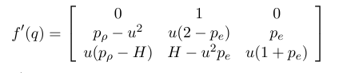

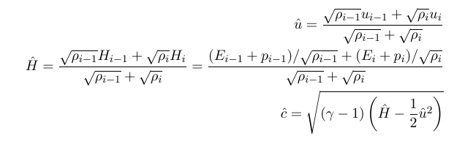
Roe Approximate Riemann Solver
Euler equations are non-linear, so Riemann problems will be non-linear
The Roe approximation seeks to linearize the flux Jacobian matrix.
Implemented by a set of parameterizations proposed by Roe.

Slide 8
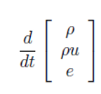
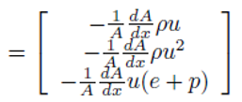

Two Stage Runge-Kutta
To advance from Q _{i}* to Q _{i}^{n+1}, we solve the ODE q_{t}=ψ(q), where ψ(q) are the source terms.
The second-order Runge-Kutta method was implemented as

Slide 9
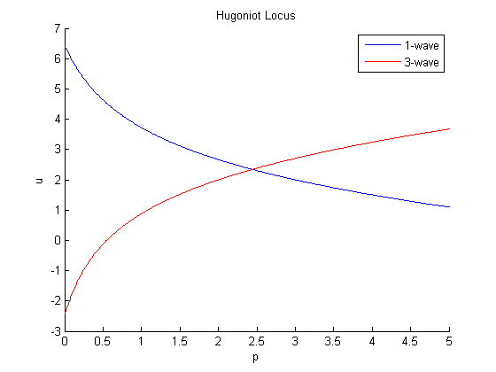




Boundary Conditions
Subsonic Inflow
Defined by 3-shock
Inflow p₀ defined and then velocity and density are defined using the Rankine-Hugoniot Conditions for the 3-shock
Subsonic Outflow
Defined by 1-shock
Outer p_{atm} defined and then velocity and density are defined using the Rankine-Hugoniot Conditions again for the 1-shock
Supersonic Outflow
All values are extrapolated from interior

Slide 10
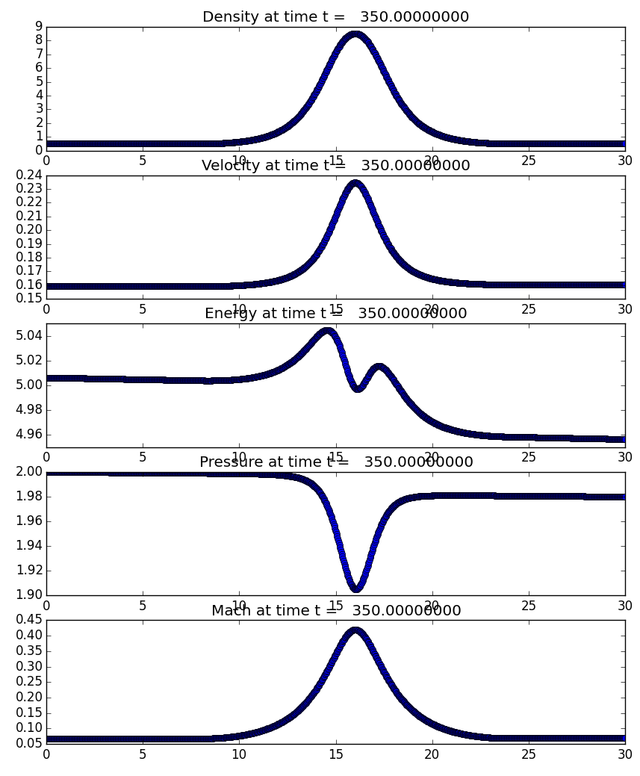
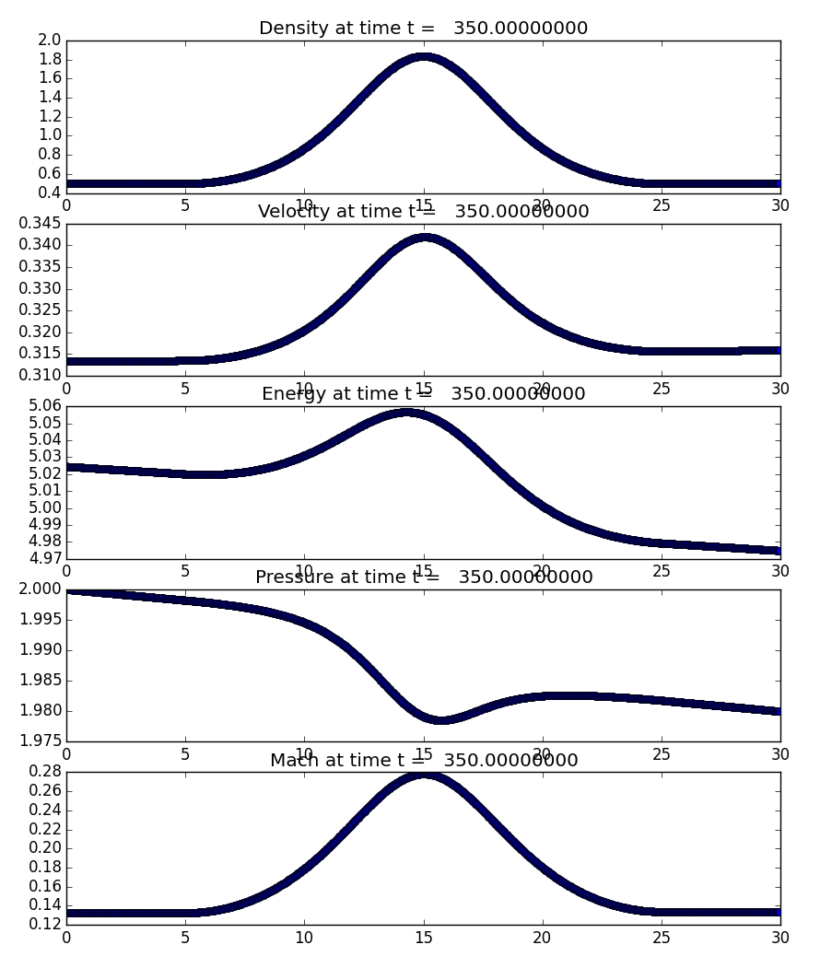
Results : Pure Subsonic, Pressure Ratio 0.99
Nozzle 1 – Area Ratio 25
Nozzle 2 – Area Ratio 4

Slide 11
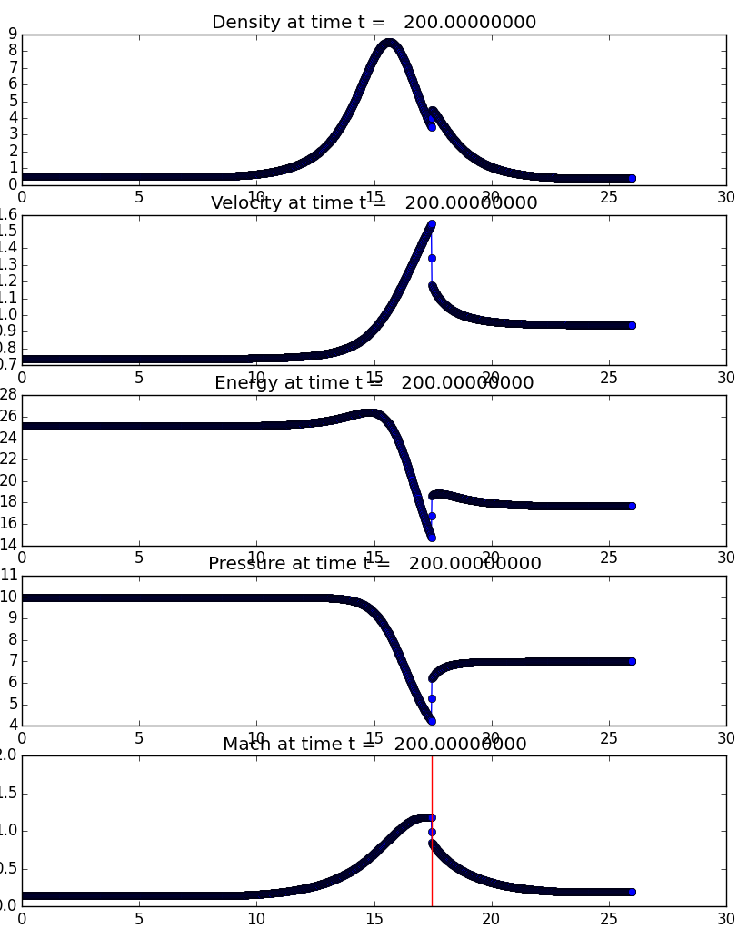
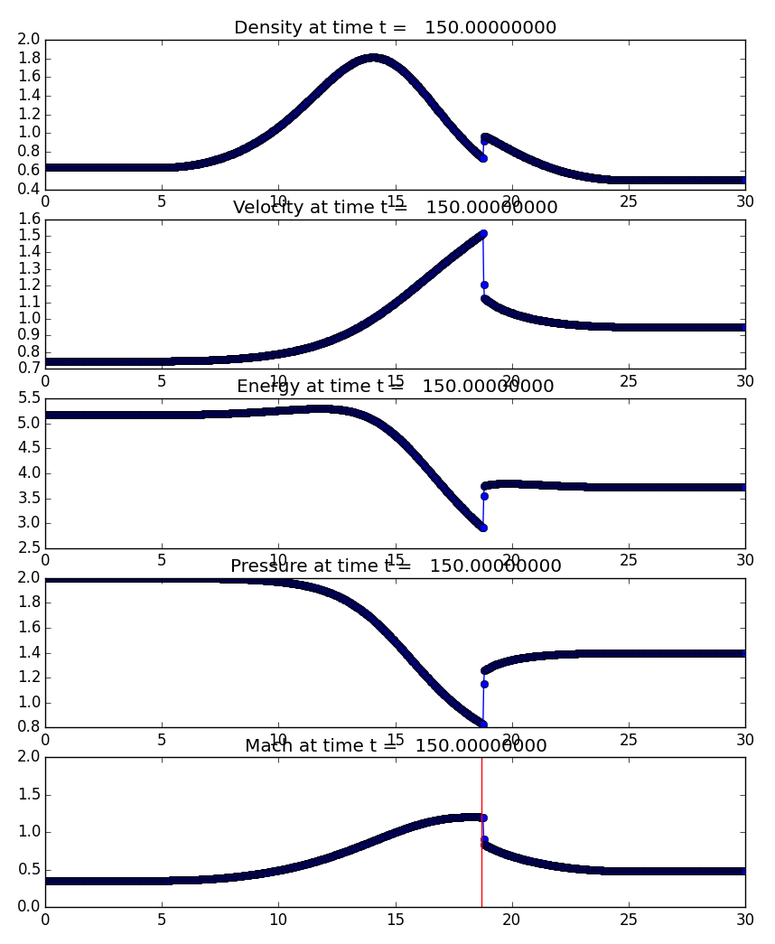
Results : Choked Subsonic, Pressure Ratio 0.7
Nozzle 1 – Area Ratio 25
Nozzle 2 – Area Ratio 4

Slide 12
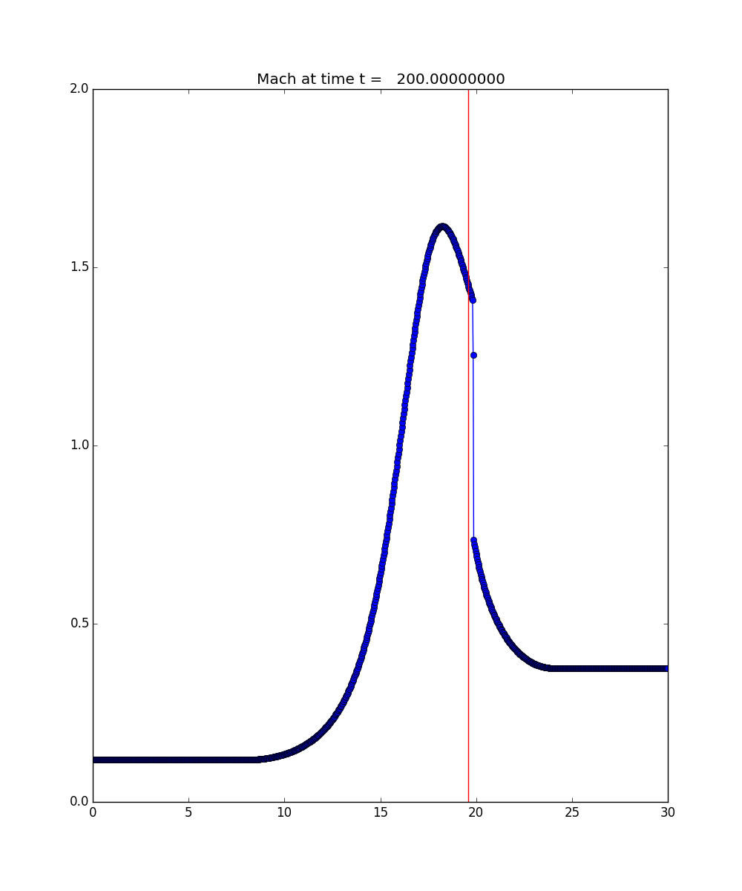
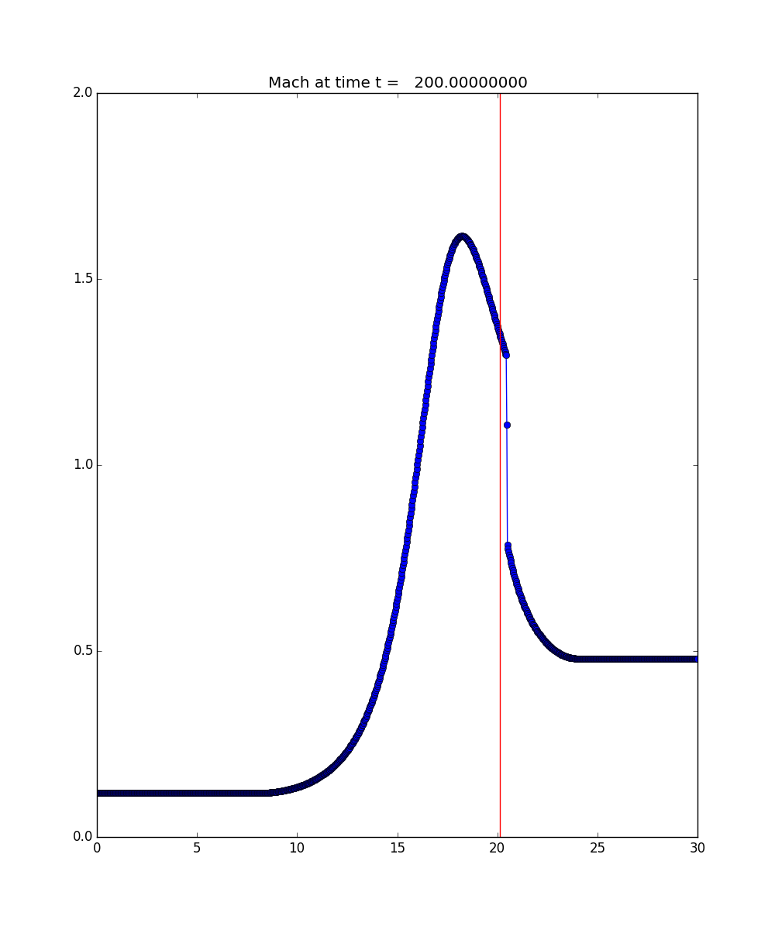
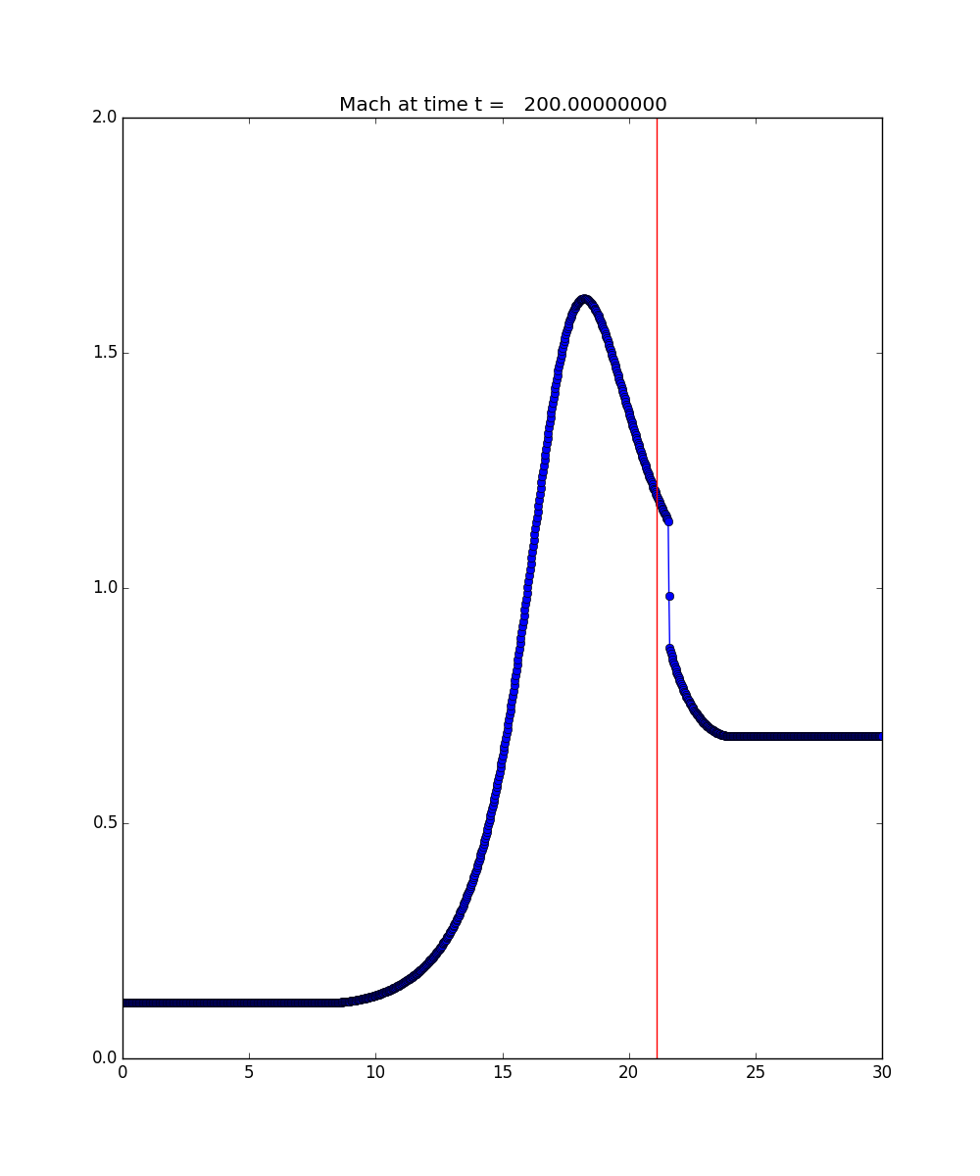
Results : Nozzle 1, Convergence Issues
Pressure Ratio: 0.2
Pressure Ratio: 0.15
Pressure Ratio: 0.1

Slide 13
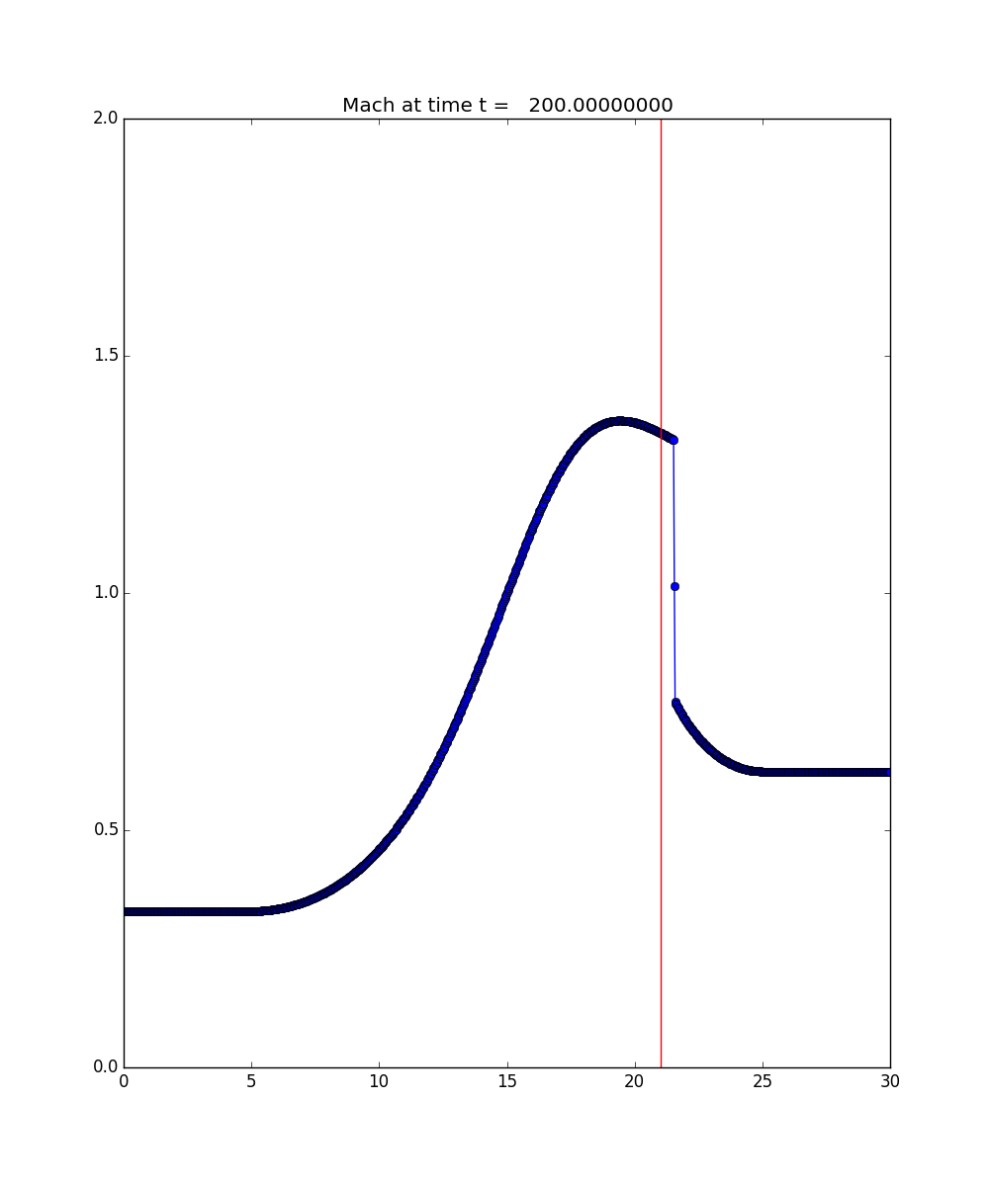
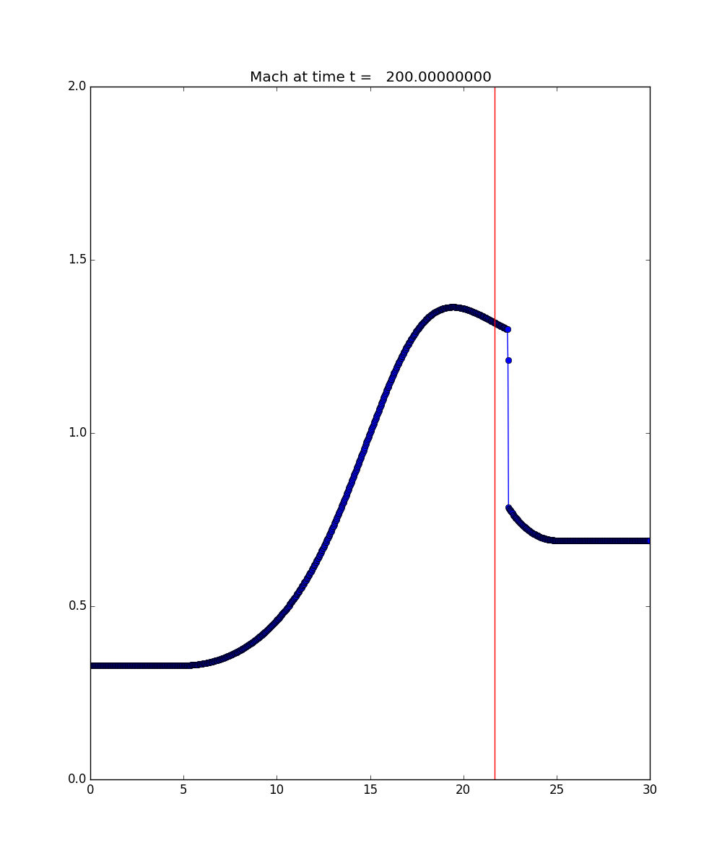
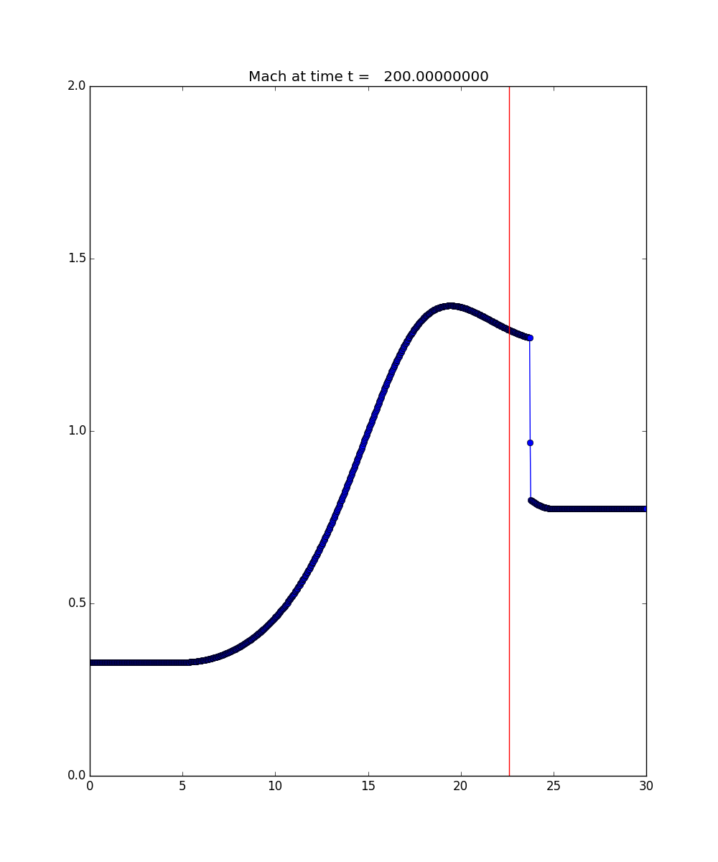
Results : Nozzle 2, Convergence Issues
Pressure Ratio: 0.45
Pressure Ratio: 0.40
Pressure Ratio: 0.35

Slide 14
References
[1] Leveque, Randall J., Finite Volume Methods for Hyperbolic Problems, Cambridge University Press, New York, NY, 2011
[2] Liepmann, H.W. and Roshko, A., Elements of Gasdynamics, Dover Publications, Mineola, NY, 1985

Slide 15
Questions?

